Slide 1

Customized Event Alert For Websites
Guide
SILPA SANGEETH L R,
Assistant Professor,
Department of Information Technology,
Government Engineering College Palakkad
Group number : 1
AYSHA C M
BALASUBRAMANIAN T K
MEENAKSHI SUNIL
MUHAMMED SUHAIL A H

Slide 2
01
02
03
Proposed System
TABLE OF CONTENTS
Abstract
Problem Statement
05
06
Use Case Diagram
Activity Diagram
04
Architecture
07
08
Mailer
GUI
Tools & Packages

Slide 3
Abstract
“
The updates in a website can be monitored with scraper script that can act as a reliable system for alerting, which saves time and act vigilant at times of critical updates.

Slide 4

Problem Statement
To build an alert system that continuously monitors and scrapes the events from websites, which then pushes it through some medium for users

Slide 5
Proposed System
Target
KTU ANNOUNCEMENTS
Event part retrieval
Transfer via medium
Cloud Monitoring
KEAM ANNOUNCEMENTS
Scraper
GEC SKP WEBSITE
Target
Target

Slide 6


Architecture
Cloud Platform
Scraper script
Timer
Extraction
Admin Works
Mailer
User Info
Alert
UI
6

Slide 7
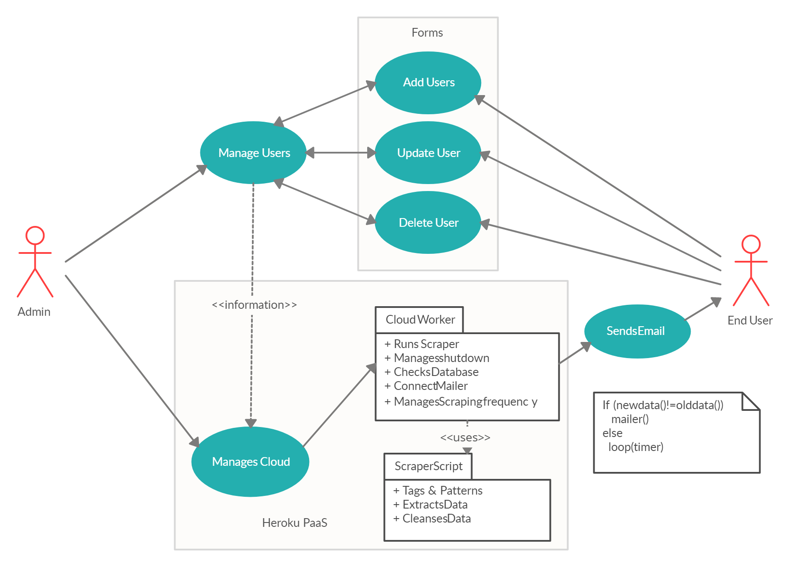
Use Case Diagram
7

Slide 8
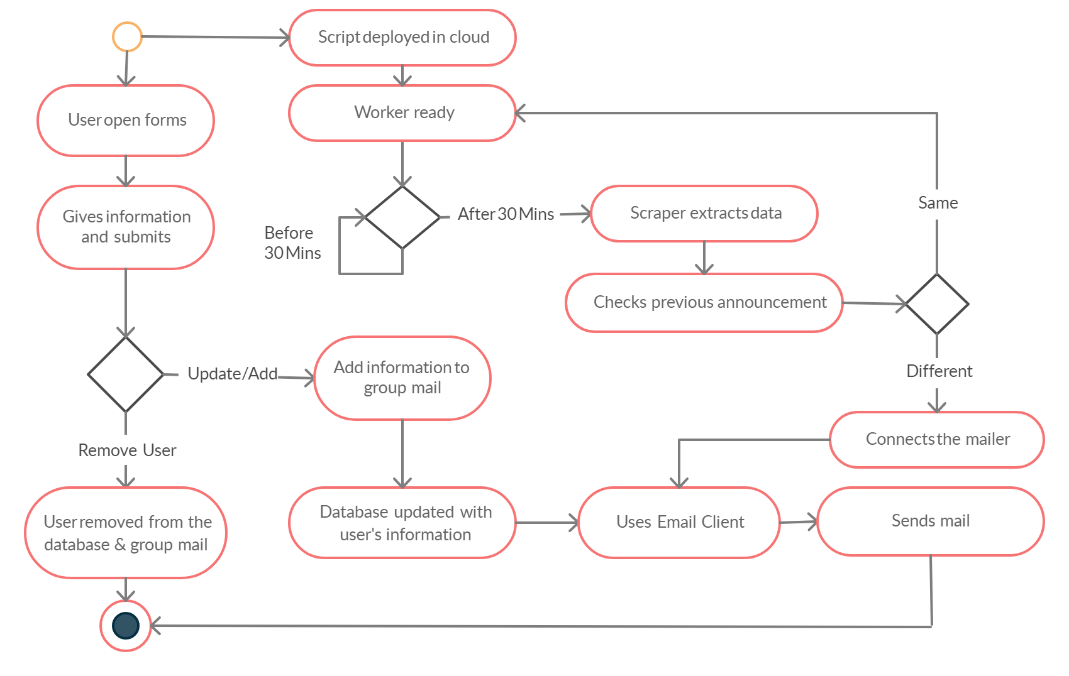
Activity Diagram
8

Slide 9
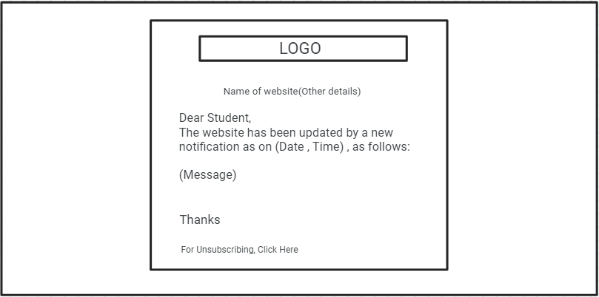
Mailer GUI

Slide 10
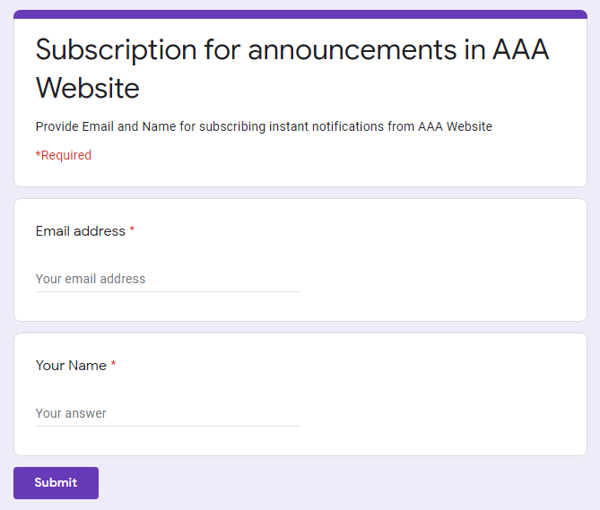
Forms GUI

Slide 11
Tools
Packages
Language : Python
Editors : VSCode, Google Colab
Collaboration : Github
Cloud Platform : Heroku (Free Tier)
Mailer : SendGrid
Mailer Storage : Sendgrid Contact
Scraper : beautifulSoup.htmlparser
Connection : urllib.request
Storage : csv.write
Mailer API: Sendgrid
Worker Timer : External Add ons
Shutdown Stoppage : time

Slide 12
References
Fujiwara, K., Nomura, Y., & Taniguchi, H. (2010). A Mailing List Management System Mashing-up with Web Services. In the proceedings International Conference on Broadband, Wireless Computing, Communication and Applications.
Maududie, A., Retnani, W. E., & Rohim, M. A. (2018). An Approach of Web Scraping on News Website based on Regular Expression. The 2nd East Indonesia Conference on Computer and Information Technology (EIConCIT) 2018 .
Zhou, Y. C., Xue, L., Liu, X. P., Wang, X. N., Liang, X. X., & Sun, C. H. (n.d.). 2010 IEEE : A Self-Service Telecommunication Service Delivery Platform with Platform-as-a-Service Technology. 6th World Congress on Services. Service Storm

Slide 13
THANKS

